Slide 1
Math 152
Lesson | Topic | Reading
31 | Taylor and Maclaurin Series | 11.10
32 | Applications of Taylor Polynomials | 11.11
33 | Parametric Equations | 10.1
Objectives:
Cal

Slide 2

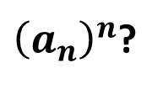

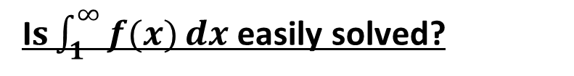
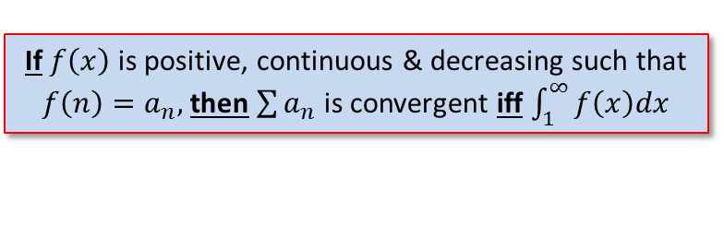
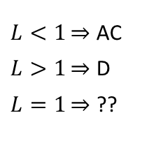
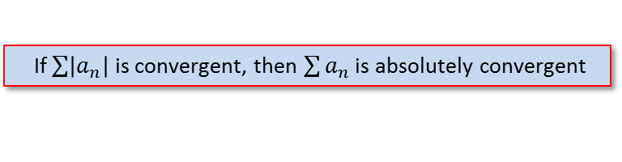
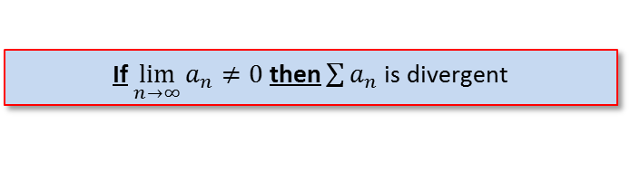


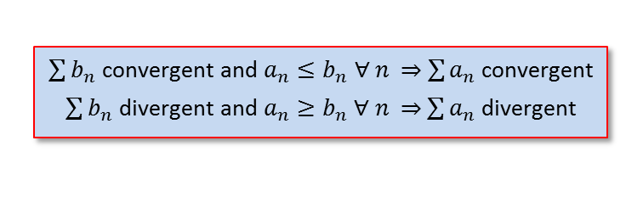
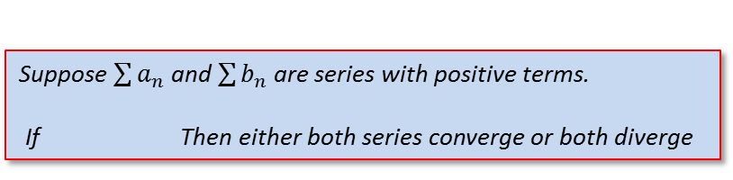

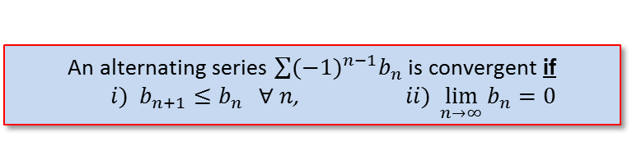
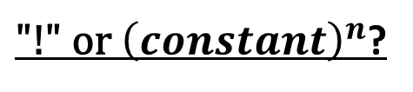
Strategy for Testing Series
Test for Divergence
If $\lim_{n→∞}{a_{n}≠0}$ then $\sum{a_{n}}$ is divergent
g-series?
Geometric converges to $\frac{a}{1−r}$ when $−1<r<1$
p-series?
$p$-series converges when $p>1$
“like” a geo- or p-series?
Comparison Test
$\sum{b_{n}}$ convergent and $a_{n}≤b_{n}$ $∀$ $n$ $\sum{a_{n}}$ convergent
$\sum{b_{n}}$ divergent and $a_{n}≥b_{n}$ $∀$ $n$ $\sum{a_{n}}$ divergent
Limit Comparison Test
Suppose $\sum{a_{n}}$ and $\sum{b_{n}}$ are series with positive terms.
If Then either both series converge or both diverge
$$\lim_{n→∞}{\frac{a_{n}}{b_{n}}}=c$$
c is a finite number & c > 0
Alternating Series?
An alternating series $\sum{{(−1)}^{n−1}b_{n}}$ is convergent if
$i) b_{n+1}≤b_{n} ∀ n$, $ii) \lim_{n→∞}{b_{n}=0}$
If $\sum{\left|a_{n}\right|}$ is convergent, then $\sum{a_{n}}$ is absolutely convergent
$L<1\overset{⇒}{}$ AC
$L>1\overset{⇒}{}$ D
$L=1\overset{⇒}{}$ ??
${\text{"!" }\text{or} \left(constant\right)}^{n}$?
$$\lim_{n→∞}\left|\frac{a_{n+1}}{a_{n}}\right|=L$$
${\left(a_{n}\right)}^{n}$?
$$\lim_{n→∞}{\sqrt[n]{\left|a_{n}\right|}}=L$$
I$s\int_{1}^{∞}{f(x)}dx$ easily solved?
If $f\left(x\right)$ is positive, continuous & decreasing such that $f\left(n\right)=a_{n},$then$\sum{a_{n}}$ is convergent iff $\int_{1}^{∞}{f\left(x\right)dx}$
Notes:
Section 11.7, p739
Comparison test: if the term is a rational function or an algebraic function of n (involving roots of polynomials), then the series should be compared with a p-series, keeping only the highest powers of n in the numerator & denominator
Ratio & Root test: inconclusive if L = 1, or DNE

Slide 3
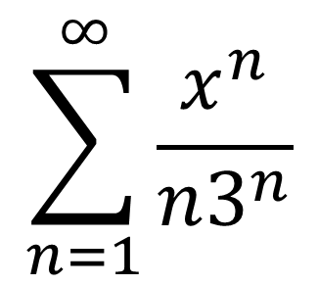
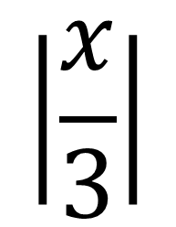
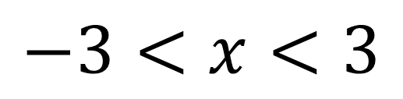
Radius & Interval of Convergence
$$\sum_{n=1}^{∞}{\frac{x^{n}}{n3^{n}}}$$
$$\left|\frac{x}{3}\right|$$
$$<1$$
Converges when
$$−3<x<3$$
Radius of convergence of 3 centered at 0
Interval of convergence is [-3, 3)
Notes:
For (-3), the series becomes (-1)^n/n, a convergent alternating series
For (+3), the series becomes (+1)^n/n, or 1/n, a divergent (p=1) p-series

Slide 4
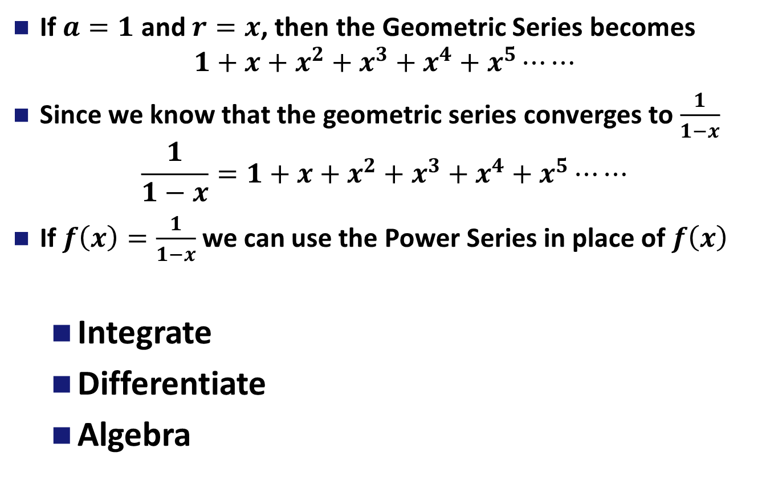
Representing a Function as a Power Series
If $a=1$ and $r=x$, then the Geometric Series becomes
$$1+x+x^{2}+x^{3}+x^{4}+x^{5}⋯⋯$$
Since we know that the geometric series converges to $\frac{1}{1−x}$
$$\frac{1}{1−x}=1+x+x^{2}+x^{3}+x^{4}+x^{5}⋯⋯$$
If $f\left(x\right)=\frac{1}{1−x}$ we can use the Power Series in place of $f\left(x\right)$
Integrate
Differentiate
Algebra
Notes:
Geometric series, where a = 1, and r = x
Ask for radius of convergence

